Slide 1
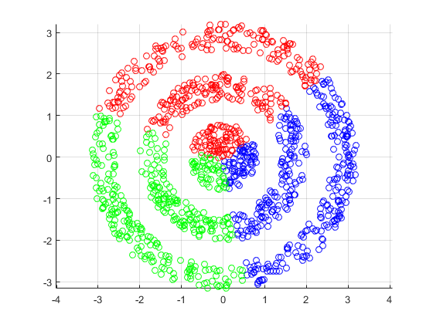
K-Means Clustering
Presented By:
Prabesh Rijal, 191625
Bibek Kunwar, 191611
REVIEWED BY :
SAMEEP SIGDEL, 191637
SUDESH MAHARJAN, 191643
SARTHAK PANERU, 191639

Slide 2
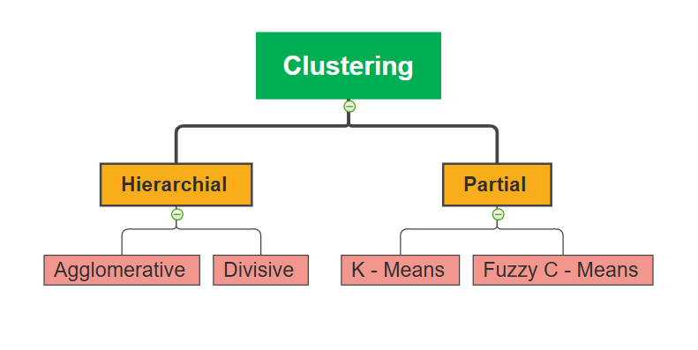
CLUSTERING
Task of grouping data in such a way such that data in same cluster are more similar to each other than to those in other clusters.

Slide 3
K MEANS CLUSTERING
Exploratory Data Analysis Technique
Implements non hierarchical method of grouping similar objects.
Determines centroid using distance measure techniques
Groups objects based on minimum distance

Slide 4
DISTANCE MEASURE
Euclidean
d=√ ⅀i=n(Qi-Pi)^2
Manhattan
d=√ ⅀i=n|Qx-Px|+|Qy-Py|
Determines the similarity of two data and influence the shape of clusters.
Let P and Q be two points
Cosine
d=(dot(P, Q) / (Magnitude (P) * Magnitude (Q)))

Slide 5
K Means Clustering Algorithm
START
Elbow Point (K)
Measure Distance from centroid
Unstable
Cluster
Grouping Based on Min Distance
Reposition of Centroid
Stable Cluster
Convergence

Slide 6

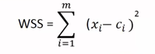
How it Works ?
How to choose the optimum numbers of clusters?? clusters??
Elbow Method
The best way is by Elbow Method.
The idea is to run K-Means clustering on the dataset where ‘k’ is number of clusters
Within Sum of Squares (WSS) is the sum of the squared distance between each member of cluster and its centroid.
xi=data point
ci=closest point to centroid

Slide 7
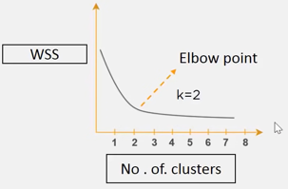
.
Elbow Point
How it Works ?
Draw curve between WSS & no. of clusters
Slow change in value WSS after k=2
Final number of clusters = 2

Slide 8
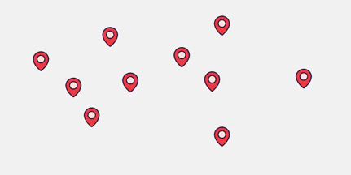
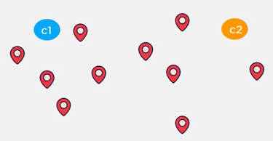
.
Elbow Point
How it Works ?
Step 1 : Assume points as delivery points.
Step 2 :
Initialize two random points called cluster centroids.
Eucledian distance, to find which data point closest to centroids
Measure Distance

Slide 9
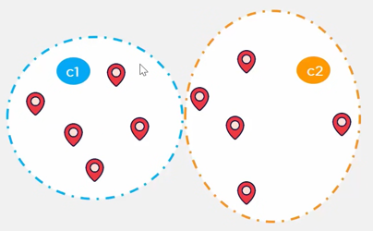
.
Elbow Point
How it Works ?
Step 3 : Based on distance from c1 & c2,data points groups itself into clusters.
Measure Distance
Grouping

Slide 10
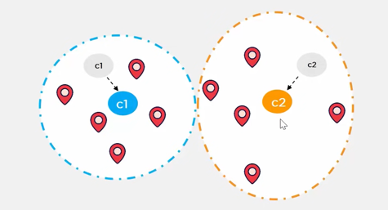
.
Elbow Point
How it Works ?
Step 4 : Compute centroid data points inside orange cluster.
Step 5 : Reposition orange cluster centroid in new centroid
Measure Distance
Grouping
Reposition Centroids

Slide 11
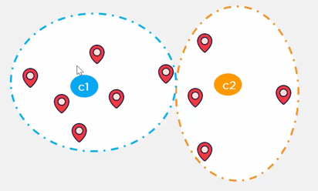
.
Elbow Point
How it Works ?
Step 6 : Once cluster become static, K-Means Clustering Algorithm is said to be converged.
Measure Distance
Grouping
Reposition Centroids
Convergence

Slide 12




Application
Academic
Performance
Diagnostic System
Image Compression
Customer
Analysis

Slide 13
Advantages
Easy to Understand
Generalizes to clusters of different shapes and sizes, such as elliptical clusters.
Guarantees convergence.

Slide 14
Disadvantages
Difficult to predict K-Value.
Clustering Outliers
It does not work well with clusters (in the original data) of Different size and Different density

Slide 15
THANK YOU

